Slide 1
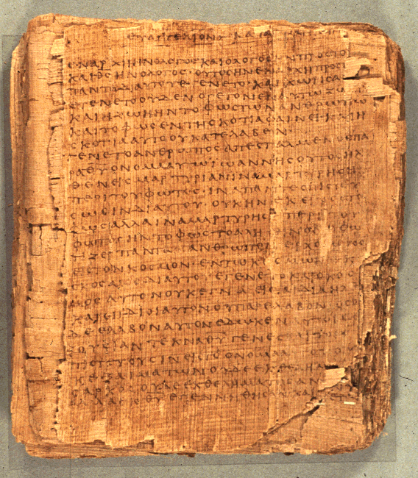
How to Read the Psalms
Dr. Rodney K. Duke

Slide 2
CLASS 2
Assign: (see handouts pp 3-4)
Write a journal reflection entry (for each class)
Assignment #2. [in handout] Discover the formal elements of different kinds of psalms. Compare and contrast 6 psalms, forming 3 sets of pairs based on common characteristics.
[Following “footsteps” of Hermann Gunkel]
Day Objectives:
Observe theological reflection through narrative, Psalm 73
Compile tentative description of psalms
Describe how psalms functioned in the Temple setting.
Define “cult” and identify Israelite cultic elements.
Notes:
Gunkel and rise of social sciences.

Slide 3

PSALM 73
Type: Wisdom / Didactic
Issue: theodicy (problem of evil and suffering)
Form: reflective narrative of experience w/maxim as confession
Teaching: the person of faith takes refuge in God
“Faith” [Heb: ‘amunah, Greek: pistis = to entrust] rests upon that which has a convicting or proofing essence about it; trustworthy. In this context, it is in the character and behavior of God. The convicting evidence of God’s Presence and behavior is why the psalmist [we] know that God holds on to us even after this body fails. [See Hebrews 11:1]
“Now faith is:
A / B
regarding what we looked to in the future / essence/reality,
A / B
regarding matters not seen / verification.” (Heb 11:1)
[John Bunyan quote]

Slide 4
JOURNAL THOUGHTS, OBSERVATIONS, & QUESTIONS

Slide 5

REVIEW
Assignments: to make and “own” one’s
observations
Journal reflection: essential step of learning.
Understanding HOW a text communicates is essential to understanding WHAT it communicates.
“Cultic” a term for ways one expresses religion
Oral compositions, (although written down) use different literary techniques from written compositions
Biblical interpretation (exegesis): Methodologically, this course is about learning to apply sophisticated communication skills you already have, which one has acquired perhaps un-consciously over time, metacognitively.
“Meaning” is the total impact of text as generated by form and content.

Slide 6
Review: How we convey meaning
What is the significance of form?
    Different literary forms impact the reader differently.
    Recognition of the form establishes our expectations and reading strategy/interpretive decisions.
    We create our message in the form which will be most effective.

Slide 7
Review: Poles of Communication
HO pp. 13-14
Emotive
Addresser
|
Means------------------------|---------------------Referent
|
Addressee
Poetic
Referential
Conative (persuasive)
Point: Different forms of communication have different emphases and different functions.

Slide 8
Point: Different functions call for different evaluations.
Functions and Evaluation (1 of 2)
1. Water consists of 2 parts hydrogen and 1 part oxygen.
2. Napoleon originated the custom of sewing buttons on the cuffs of dress jackets.
3. I am the best candidate!
4. Use this deodorant and you will become romantic.
5. It is so hot outside, I’m burning up.
6. I love you.
7. Once upon a time a tortoise and a hare had a race….(assume the rest of the story)

Slide 9
Functions and Evaluation (2 of 2)
8.
“Fall Scene”
red
green
orange
twirls
gentle
leaf
home

Slide 10
Summary/Application on "Function and Evaluation” (1 of 2)
What can you apply from this exercise to reading the Bible?
Main Observation:
Before we as readers assess the value/meaning of a biblical text (or any text), we need to understand the intended communicative function of that text.
[Comment: When it comes to the Bible, people tend to drop their usual reading skills and read the Bible “on the flat” as if it were all referential and to be evaluated as science.]

Slide 11
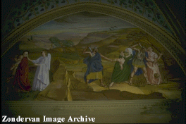
Summary/Application on "Function and Evaluation” (2 of 2)
But:
Some genres do not function referentially or conatively in a
“literalistic” sense. There may be a “poetic” impact intended.
[Duke: “literal” according to context of communicative intention vs.
“literalistic” ignoring contexts, intention, figurative lang. etc.]
Illust.: "If your eye causes you to sin, pluck it out....” (Conative and poetic poles work together = “hindrances to the Kingdom of God are so serious …”
b. Some texts do function referentially (historically or theologically),
and should be evaluated differently than
scientifically referential texts.
(Ref #2 vs #1)

Slide 12
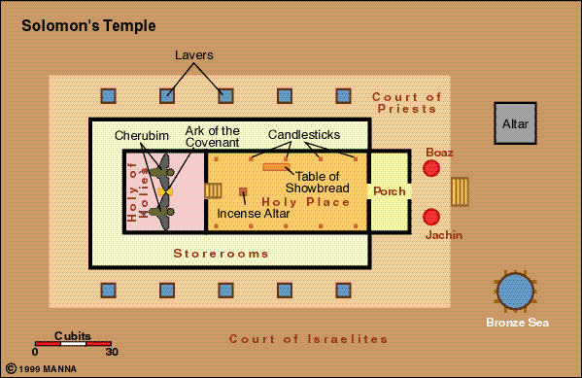
Using the Bible to compute π

Slide 13
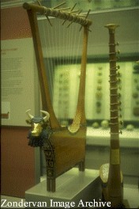
Group Work on #1: Using your assignment observations, combine your results to create a tentative literary description.
What rhetorical intentions is/are the speakers trying to achieve?
What can we observe about the speakers?
What can we observe about the addressees?
What means (strategies, features) are employed?
What kind of referent (topics, themes)?
------------------
Your main observations and questions?
Lyre, used for the queen of Ur

Slide 14
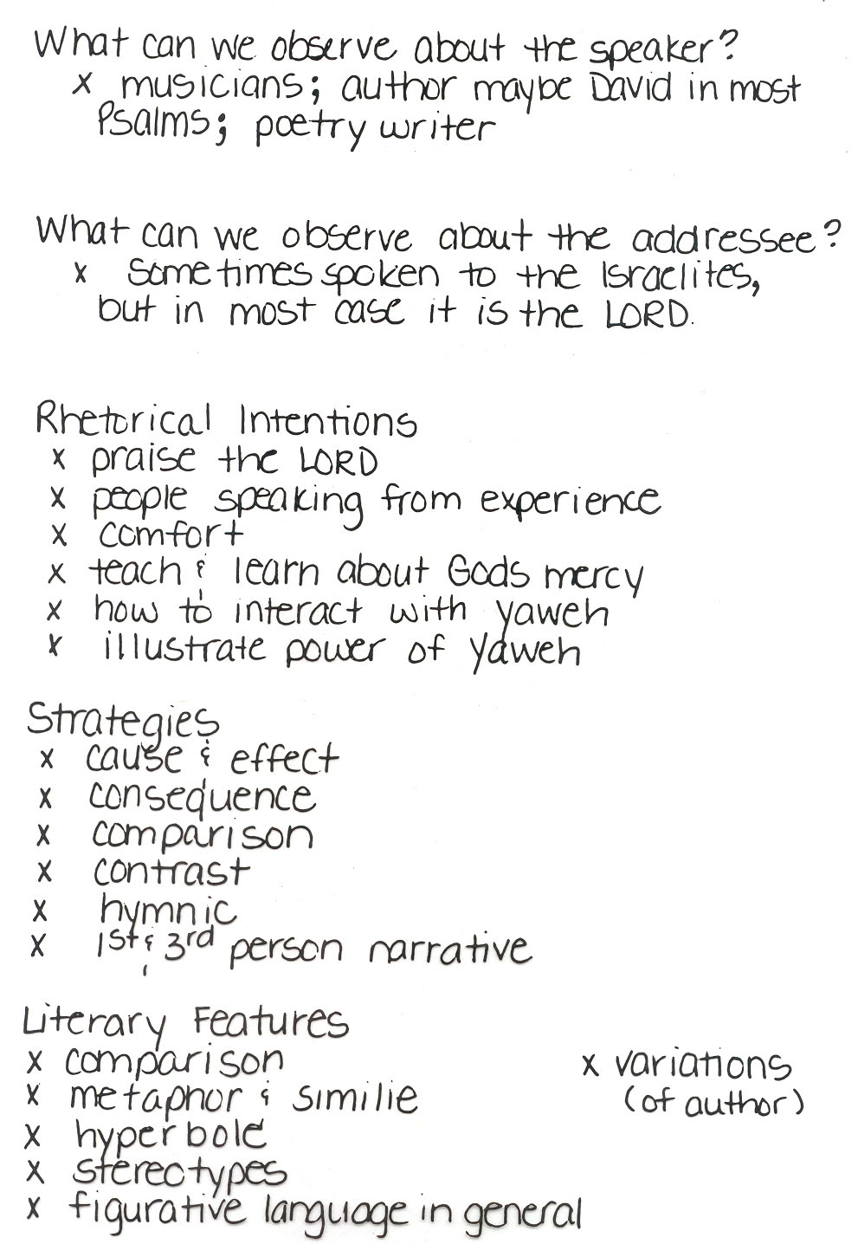
Review: #1
Often missing:
E.g. If addressed to God, then the intention involves getting God to know something and to act.
Notes:
Pt: Most people summarize what they think a text means. Once they try to describe a literary genre, hopefully, they start thinking about how it means (literary features) and why (its communicative intention. Actually, good textual interpretation follows the reverse order: why (intention) how (key features) and then what.

Slide 15
Purpose / Main Point for Assign. #1
Most people summarize what they think a text means.
When describing a literary genre, hopefully, they start thinking about how it means (literary features) and why (its communicative intention).
Good textual interpretation follows the reverse order: why (intention of the genre), then how (key features), and then what it means.

Slide 16
Assign. #1: Observations about Rhetorical Intentions
[Preparation for Assign. #2]
2/3 of all psalms have one of 3 Rhetorical Intentions:
get God to do something,
thank God for something already done,
praise God in general for God’s nature.
Doing Assign. #2. Look for formal features such as:
rhetorical intention
mood, mood shift
temporal orientation of the speaker
(present, past, atemporal)
addressee, addressee shift

Slide 17
Process of Communication Chart (HO, p. 15)
Speaker
Rhetorical intent
Rhetorical strategy/“rules”
Literary features
Medium
Referent
text
Form
Content
creates =
effective
communication
Reading strategy/ “rules”
= effective communication
Rhetorical impact
Addressee

Slide 18
APPLICATION OF PROCESS OF COMMUNICATION
When reading a specific OT text:
General
1. Identify the literary genre and its function(s) in general.
2. Identify the general literary features of that genre and their
intended impact. (Create a "Reading Strategy")
Specific
3. Identify the literary features of a specific text and their specific
impact. (Apply Reading Strategy)
4. Evaluate in terms of intended function/total impact.

Slide 19
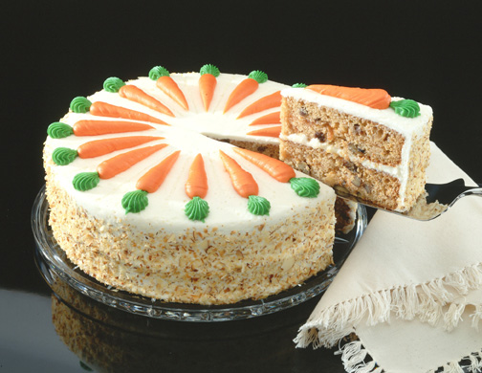
Genre Recognition
Failure to employ a reading strategy that recognizes the types/genres of literature in the Bible and their original functions:
1. Obscures the variety of forms employed in the Bible and makes communication MORE difficult. (People employ different genres to AID communication.)
2. Locates the meaning of the text in the hands of the reader (leading to unintended applications) rather than locating the meaning in the author’s intention.
3. Promotes private and self-centered readings of the Bible (“God speaks to ME”), rather than an informed and communally guided interpretation.
4. Often leads to an “atomizing” of the text.
(Illustration: favorite cake)
The form and function of the biblical text should
influence the form and function of the sermon.

Slide 20
NATURE OF THIS CLASS
Our literary goal will be to define and describe the psalms by discovering the following information:
Speaker, audience, means, referent.
Rhetorical intention
Rhetorical strategies
Literary features and their intended impact
Guidelines for reading and application
Historical context (relationship to ANE lit., authorship or origin, setting of use and/or transmission, etc.)
Theological basis and/or themes

Slide 21
Define “Cult”/“Cultic”
Any tangible expressions of religion (rituals, gestures, places, objects, personnel, seasons, etc.)

Slide 22
Today Ancient Israel
Rituals
Gestures
Places
Objects
Personnel
Seasons

Slide 23
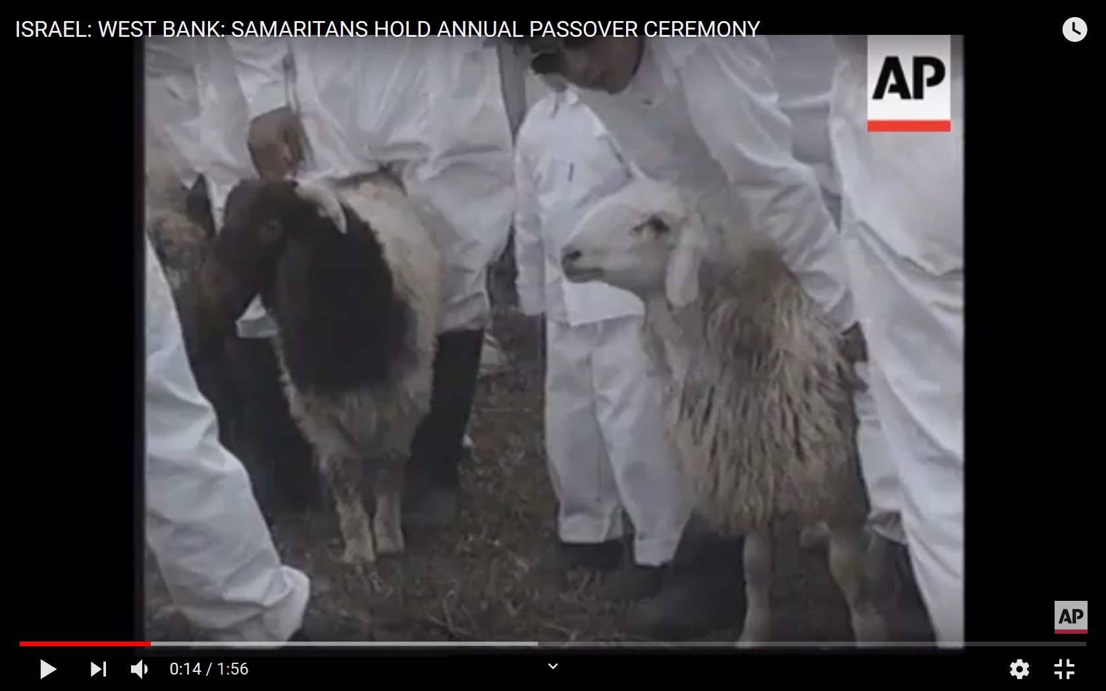
SAMARITAN VIDEO
Notes:
Start at c. 50 sec.

Slide 24
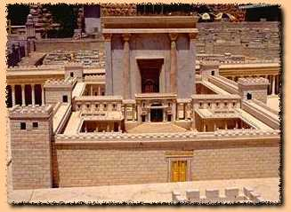
How to Read the Book of Psalms?
Psalms are NOT simply poems or songs.
They were functional songs: “cultic” expressions of faith – part of various religious rituals in specific settings for specific purposes.
How do cultic elements in your church setting aid people to worship God?
Notes:
Might compare to church baptismal rituals.

Slide 25
Overview
Setting of transmission and employment
1. Whatever the origin of the Psalms, they seem to have been used
in the Temple worship as collected “books” of psalms.
2. The Psalms as we have them have been made very generic:
enemies, illnesses, threats, occasions of joy, etc. are stated in
general terms.
3. As a result, the Psalms have become applicable to all people.

Slide 26
Illustrate cultic reading thanksgiving meal

Slide 27
Communication Chart
Speaker
Rhetorical intent
Rhetorical strategy/“rules”
Literary features
Medium
Referent
text
Form
Content
creates =
effective
communication
Reading strategy/ “rules”
= effective communication
Rhetorical impact
Addressee

